Slide 1



TEACH
FOR QAZAQSTAN
2024-2025
A Year of Change, Growth and Inspiration

Slide 2


OUR VISION, MISSION, AND VALUES
THEY ARE THE RESULT OF OUR COLLABORATIVE WORK, FIELD EXPERIENCE AND ACTIVE LISTENING- TO EACH OTHER AND THE WORLD AROUND US.
Our goal
by 2027 is to:
Our mission
Recruit the best university graduates and professionals from various fields to the teaching profession.
Provide 25,000 children from diverse schools in vulnerable rural and urban contexts with modern educational opportunities.
Create a community of leaders and change agents who have entered education from different professional backgrounds.
Introduce progressive teaching practices and technologies into 40 general education schools.
We are building a community that drives systemic change to fulfill children’s potential and strengthen their belief in themselves and the world
Our values
1
2
3
4
5
Justice
Commitment
Inclusion and Diversity
Faith
Collective Leadership

Slide 3
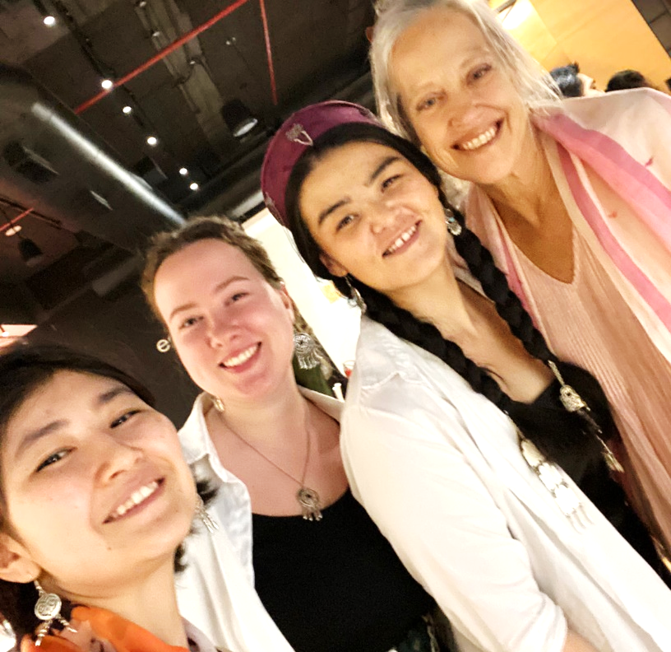
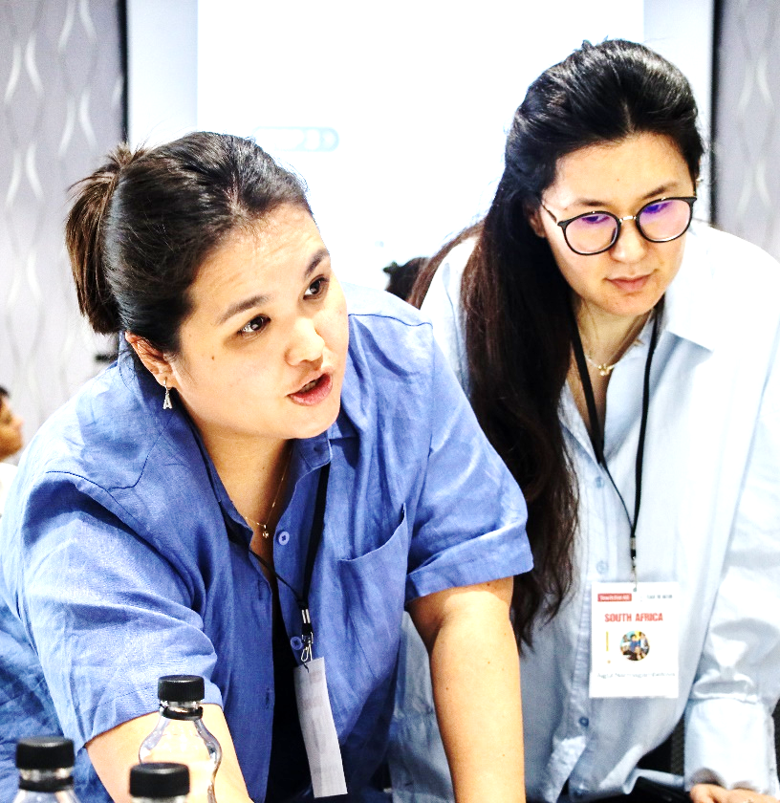
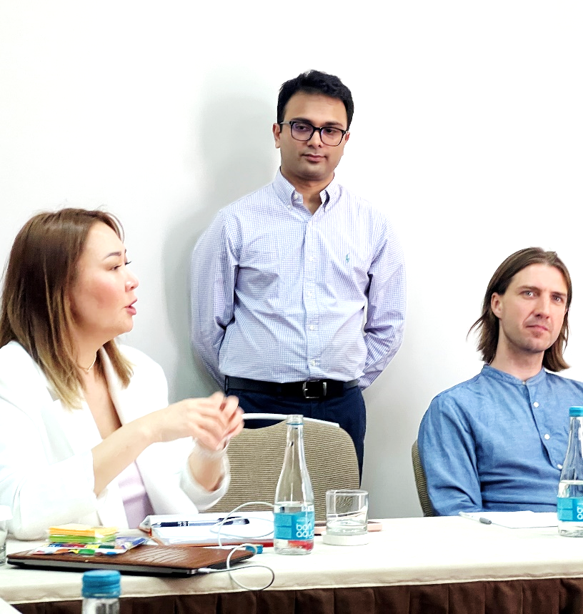
STRONGER TOGETHER:
GLOBAL PARTNERSHIP WITH TEACH FOR ALL
Our team regularly participates in online training and offline events organized by global experts. This allows us to stay up to date with global trends and implement best educational practices in our country.
Online Training
Offline Events
Course: Theory of Learning and Unlearning
APAC Development Refresher Sessions (fundraising development)
Deep Dive: Evolutionary methods for collective leadership development
Training on Diversity, Equity & Inclusion
Inner Leadership for Systemic Change
Unlocking the Secrets of Systemic Leaders
Peer Learning Experience with Teach for Malaysia
Alumni Summit (India)
Central Asia Regional Meeting (Tashkent)
Learning Cycle: Collective Leadership – Evolving Ways of Working (South Africa)
Global Forum for Shaping a Better Future (Singapore)
Leadership Retreat for Asia-Pacific Region Partners (Indonesia)
Inclusive Education Summit (Chile)

Slide 4
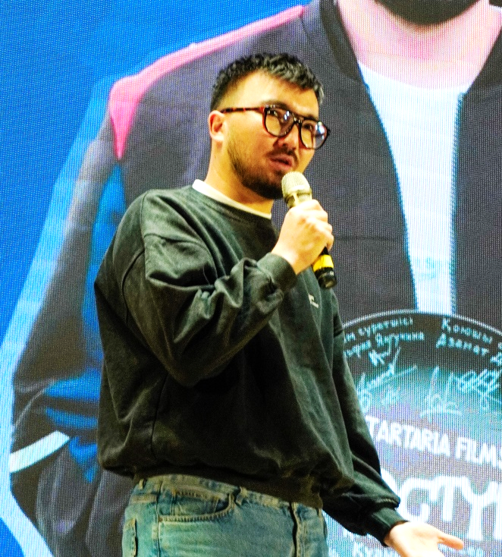
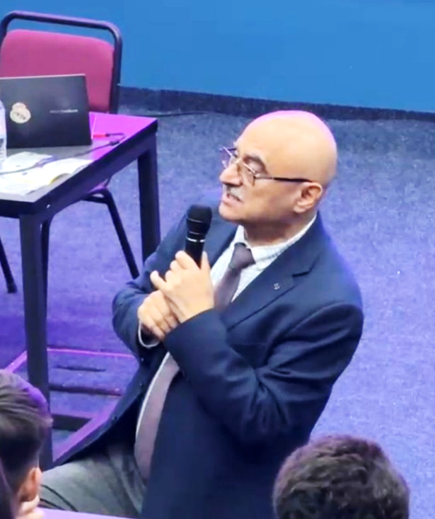
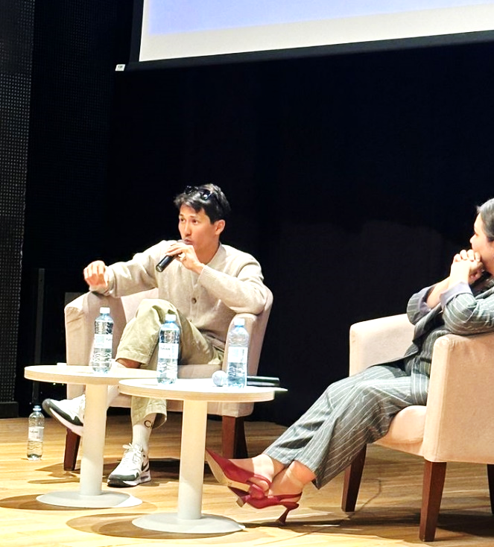
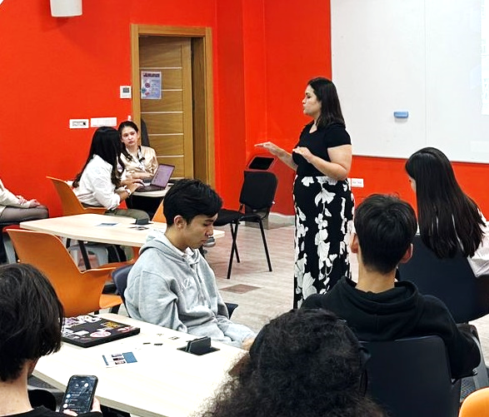
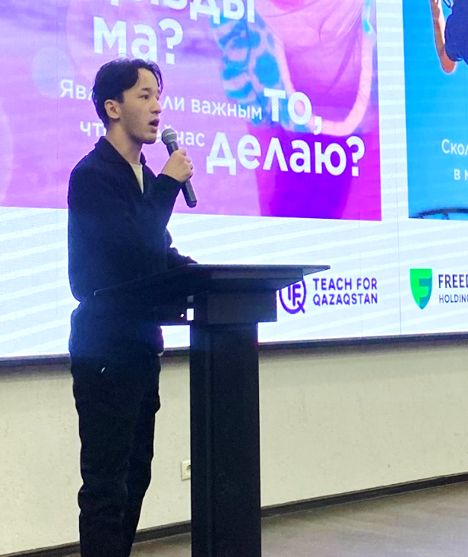
HOW WE RECRUIT
OUR NEW TALENTED FELLOWS
45
events
Changes in 2024
Campus events
Student clubs
Recruiters in Astana, Almaty, and Karaganda
High Potential Candidate (HPC) filtering
1-on-1 calls
Meetups with current fellows
Weekly webinars
Guest lectures (e.g., Narikbi, Fuad Gadzhiev, Dulatbek Ikbaev, Kuanish Beisek, Eskendir Bestai)
Quizzes,
Сase competitions,
Programme presentation
TFQ Talks
Club member trips to regions: Balkhash, Abai, Shakhtinsk
Training, immersion, coaching sessions
Volunteering during the selection – Almaty, Astana
Organizing events
9
target universities
2
student clubs
2500
potential candidates

Slide 5
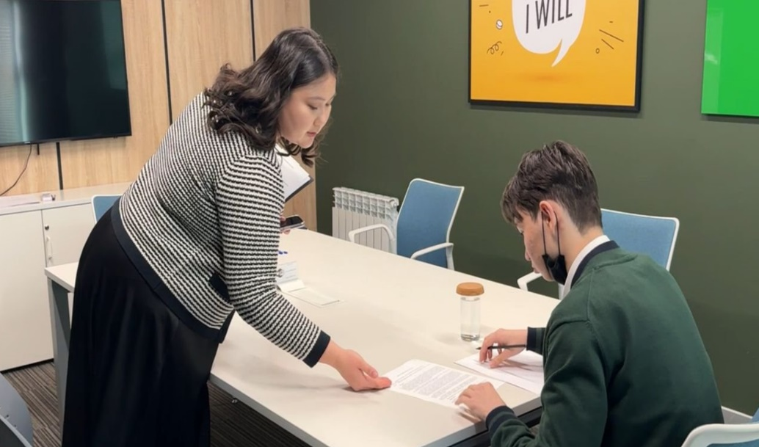
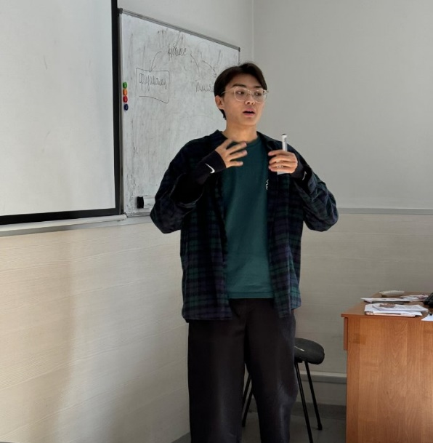
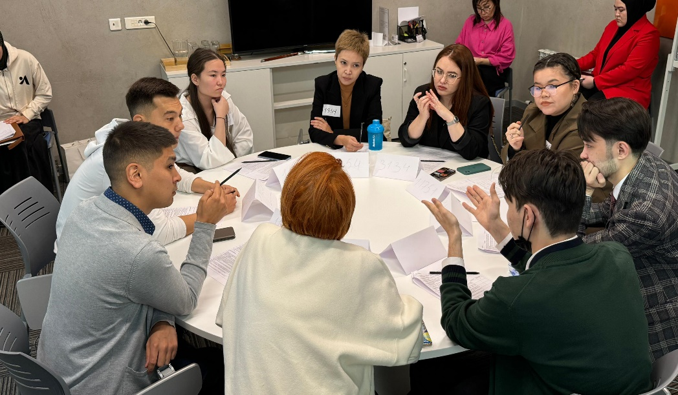
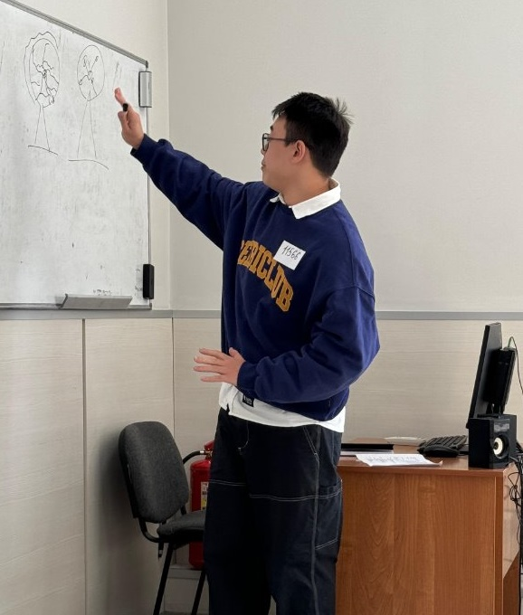
PROGRAM COHORT 3 SELECTION PROCESS
1
Website registration
2
Stage 1
3
Stage 2
Application Submission and Technical Review
Testing: verbal reasoning and abstract thinking
Video Interview
Demo Lesson
Group Discussion
Role Play
THERE WERE 2 ROUNDS IN THE 3RD COHORT SELECTION:
Round 1:
September – November 2024
Round 2:
November 2024 – February 2025
Our staff were trained in assessment and began working as internal assessors.
Photo: In-person assessment, Round 1
RESULTS OF RECRUITMENT AND SELECTION FOR THE 3RD COHORT
2471
website
registrations
866
applications
360
Stage 1 1
91
Stage 2
37
Finalists selected

Slide 6
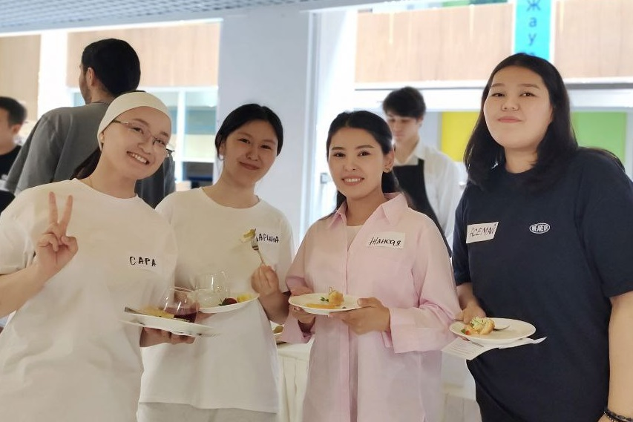
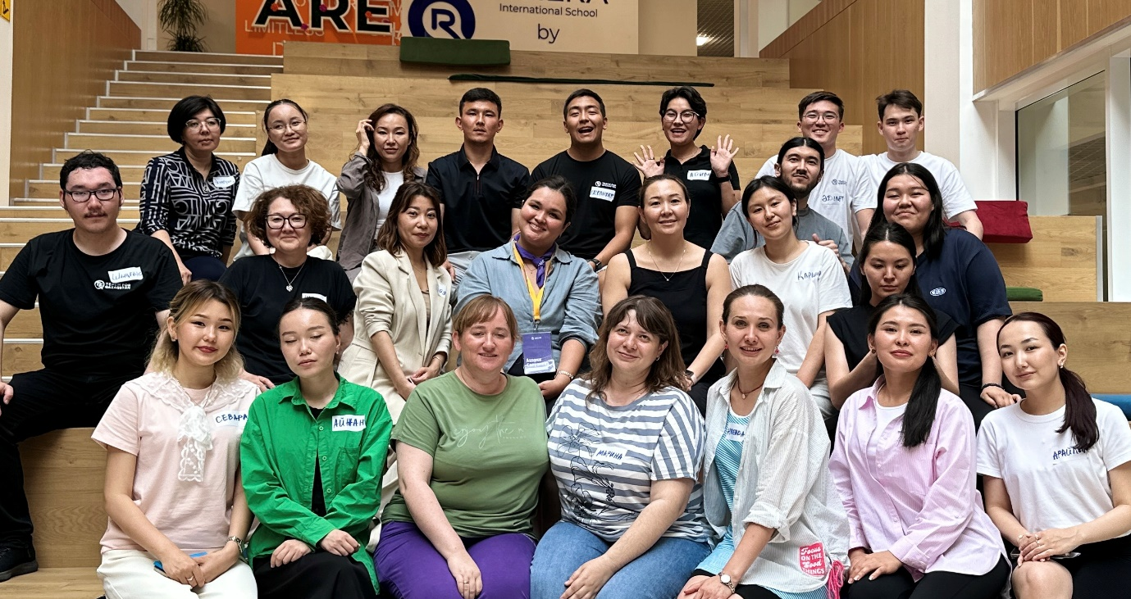
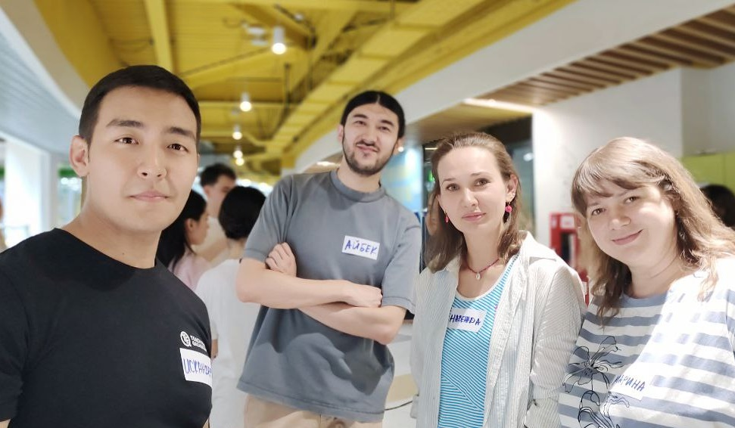
WELCOME ON BOARD:
HOW WE SUPPORT OUR NEW FELLOWS
37
Seminars
Support System
Offline Event:
finalists
Immersion Topics: TFQ values, educational inequality, leadership within the program
Daily Life Topics: Relocation, regional adaptation, preparation for the Summer Institute
Buddy Support: Fellows from Cohort 1 assist with regional adaptation, special project planning, and overcoming challenges
1-on-1 Calls: Biweekly calls with the team to address questions and provide support
Event in Astana:
Discussing educational inequality Preview of the Summer Institute: Dates, location, and academic program
Team-building quest game
12
onboarding seminars
15
buddies from
Cohort 1

Slide 7
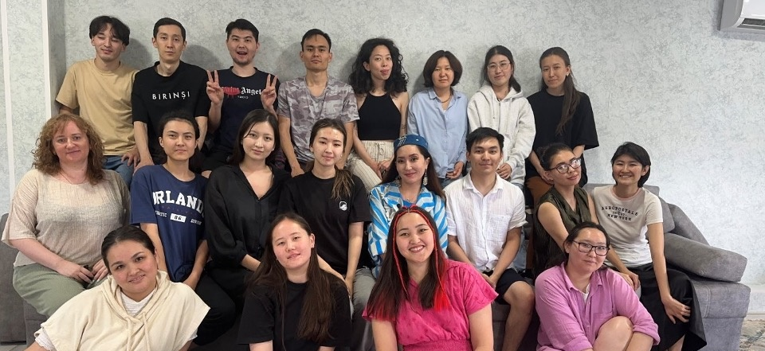




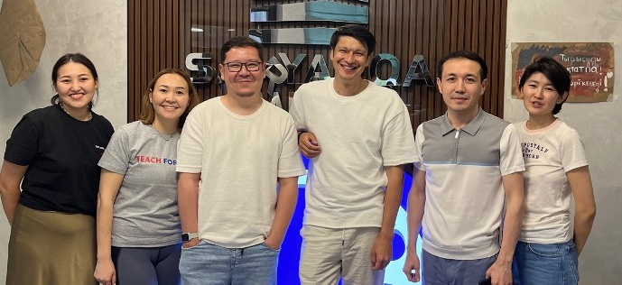
OUR DEVELOPMENT PROGRAM:
PEER SUPPORT AND TEAM GROWTH
Immersion
Finalists completed a 7-part online seminar series on inequality and the TFQ mission, along with up to 10 subject-specific webinars with trainers.
IN 2024,
32
fellows
5-week intensive
Topics: pedagogy, local context, student development competencies, inequality issues
37 days of joint learning, 250 training hours, 20 hours of reflection, 7 days in an educational camp
Summer
Institute
ARE TEACHING OVER
3500
Training & Support
Ongoing Regional Support:
Mentoring by experienced educators
Monthly classroom visits, feedback, and co-planning
420 coaching and methodological support sessions
students
in 9
schools
Constant improvement
4 in-person two-day seminars every two months to boost teaching skills and emotional resilience
15 webinars: Humanistic frameworks, PBL, social projects, differentiation, inclusion

Slide 8
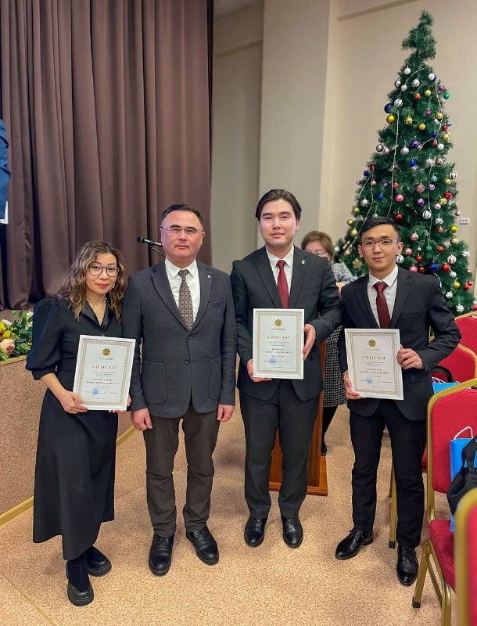
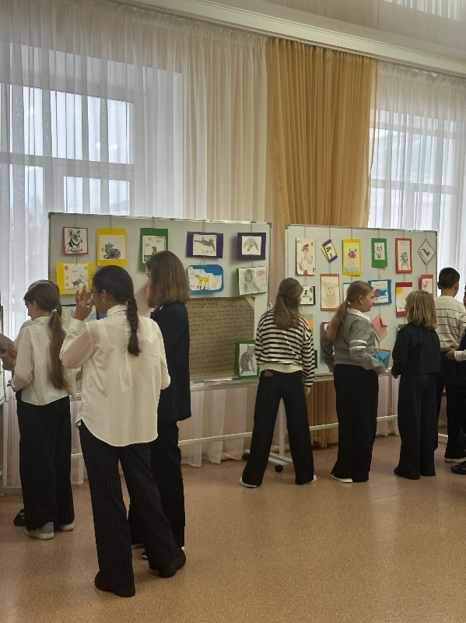
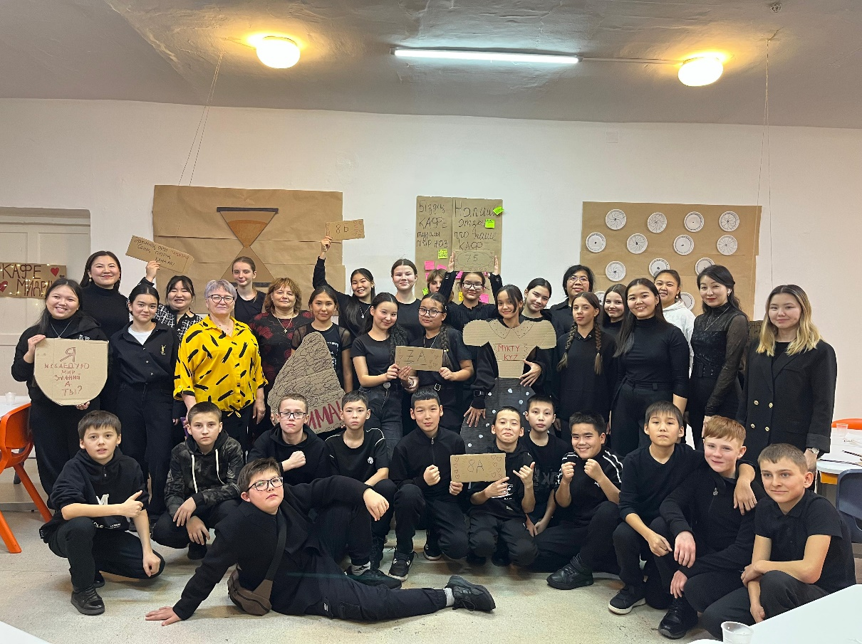
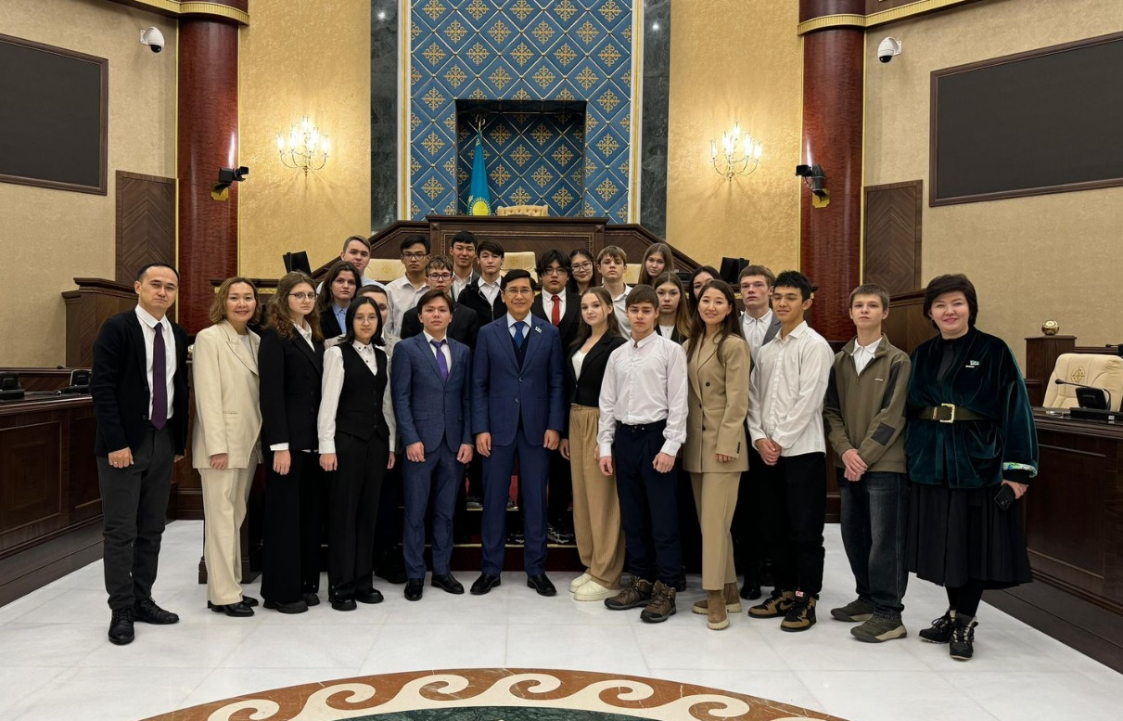
FELLOW ACHIEVEMENTS IN 2024
1st place in national and international Olympiads in computer science and physics
Grand Prix in the city stage of Best Ideas competition named after Lyazzat Baiyshkyzy
Bronze medal at the IMPACT Olympiad—an international creative competition for teachers and Olympiad trainers in math, physics, and IT
"Anti-Bullying" Project in regional schools as a model of experience sharing
1st place in the Üzdik Ideyalar Sıysy competition
Participation in the Zhas-STAR regional Olympiad for young teachers
Participation in Uzdik ITUstaz computer science teacher tournament and AlgoBatyr competitive programming championship
Student Podcast at M. Zhusip School – pos. Novaya Uzenka
Pedagogy Seminar Series for teachers in collaboration with the university – M. Zhusip School
PBL-based Lessons on Animals followed by student exhibitions – K. Satpayev and N. Abdirov Schools
Field trips for students from Abai school to Parliament (10th grade) and to the AI exhibition at Astana IT
"Letters of Kindness" – communication project
"SAQ" Project on safety
“Talented Teacher for Talented Children” city competition – 2nd place, 2 participants
2nd place at the city scientific conference “Alikhan Bukeikhanov – A National Figure”

Slide 9
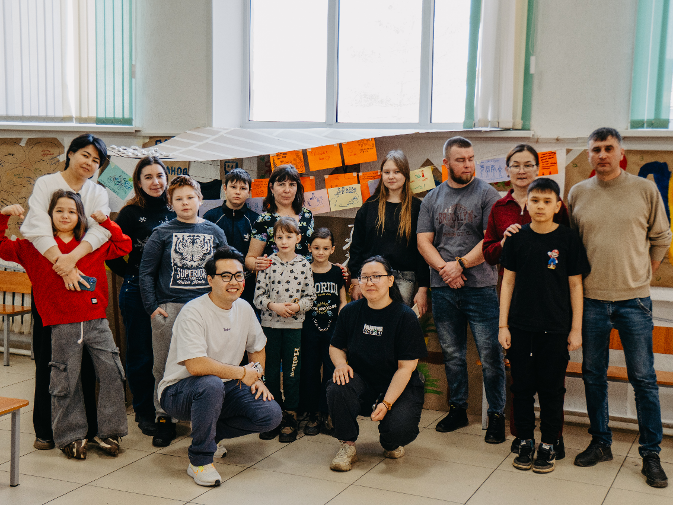
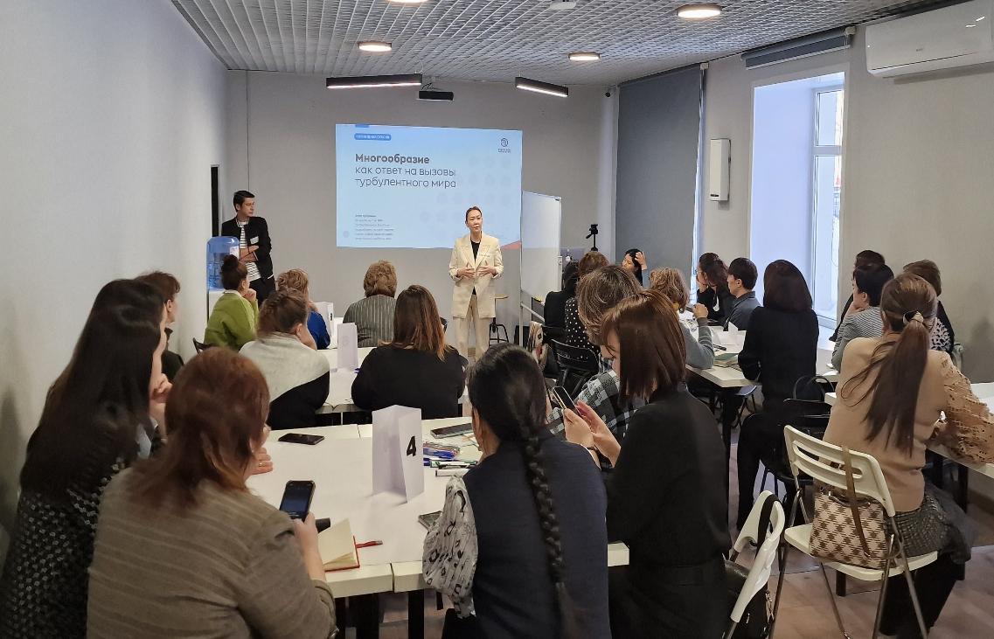
RESEARCH & DEVELOPMENT FOCUS:
BUILDING ALUMNI AND LOCAL COMMUNITIES
Local Communities
Alumni Community
Program for Active Teachers in Partner Schools:
Community-building initiative (in development)
Training sessions held for 400+ teachers across 7 partner schools
Program for School Management Teams:
Offline training events for ~40 staff members from 9 schools
TFQ Community Project Fund:
Financial support for initiatives by fellows, students, school teams, parents, and TFQ staff (pending approval)
A value proposition document for TFQ alumni was developed to guide graduate engagement
Internships held for 3 graduates pursuing career development within the program
Professional Track
for Cohort 1 Participants
Courses delivered in the following areas:
Social Innovation
Education Research Fundamentals
Education Management
Teacher Leadership

Slide 10
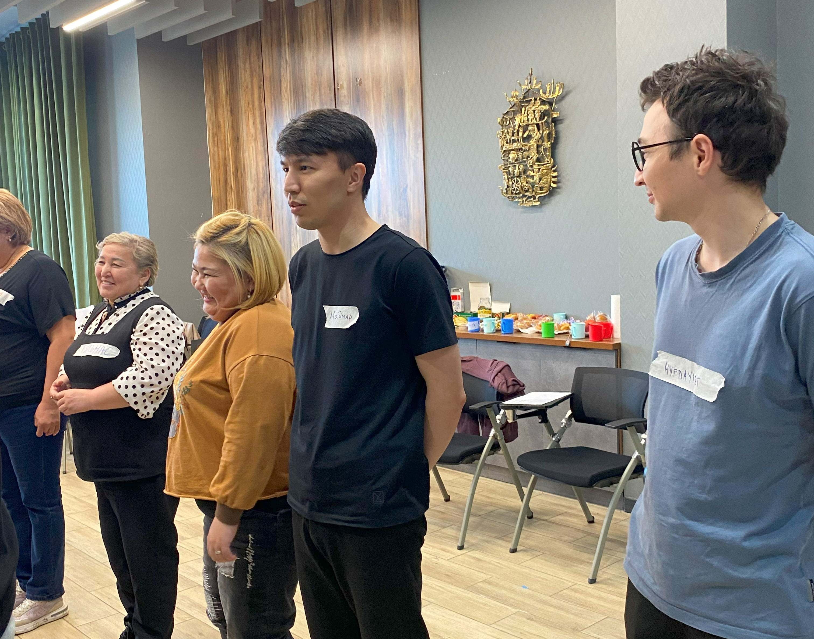
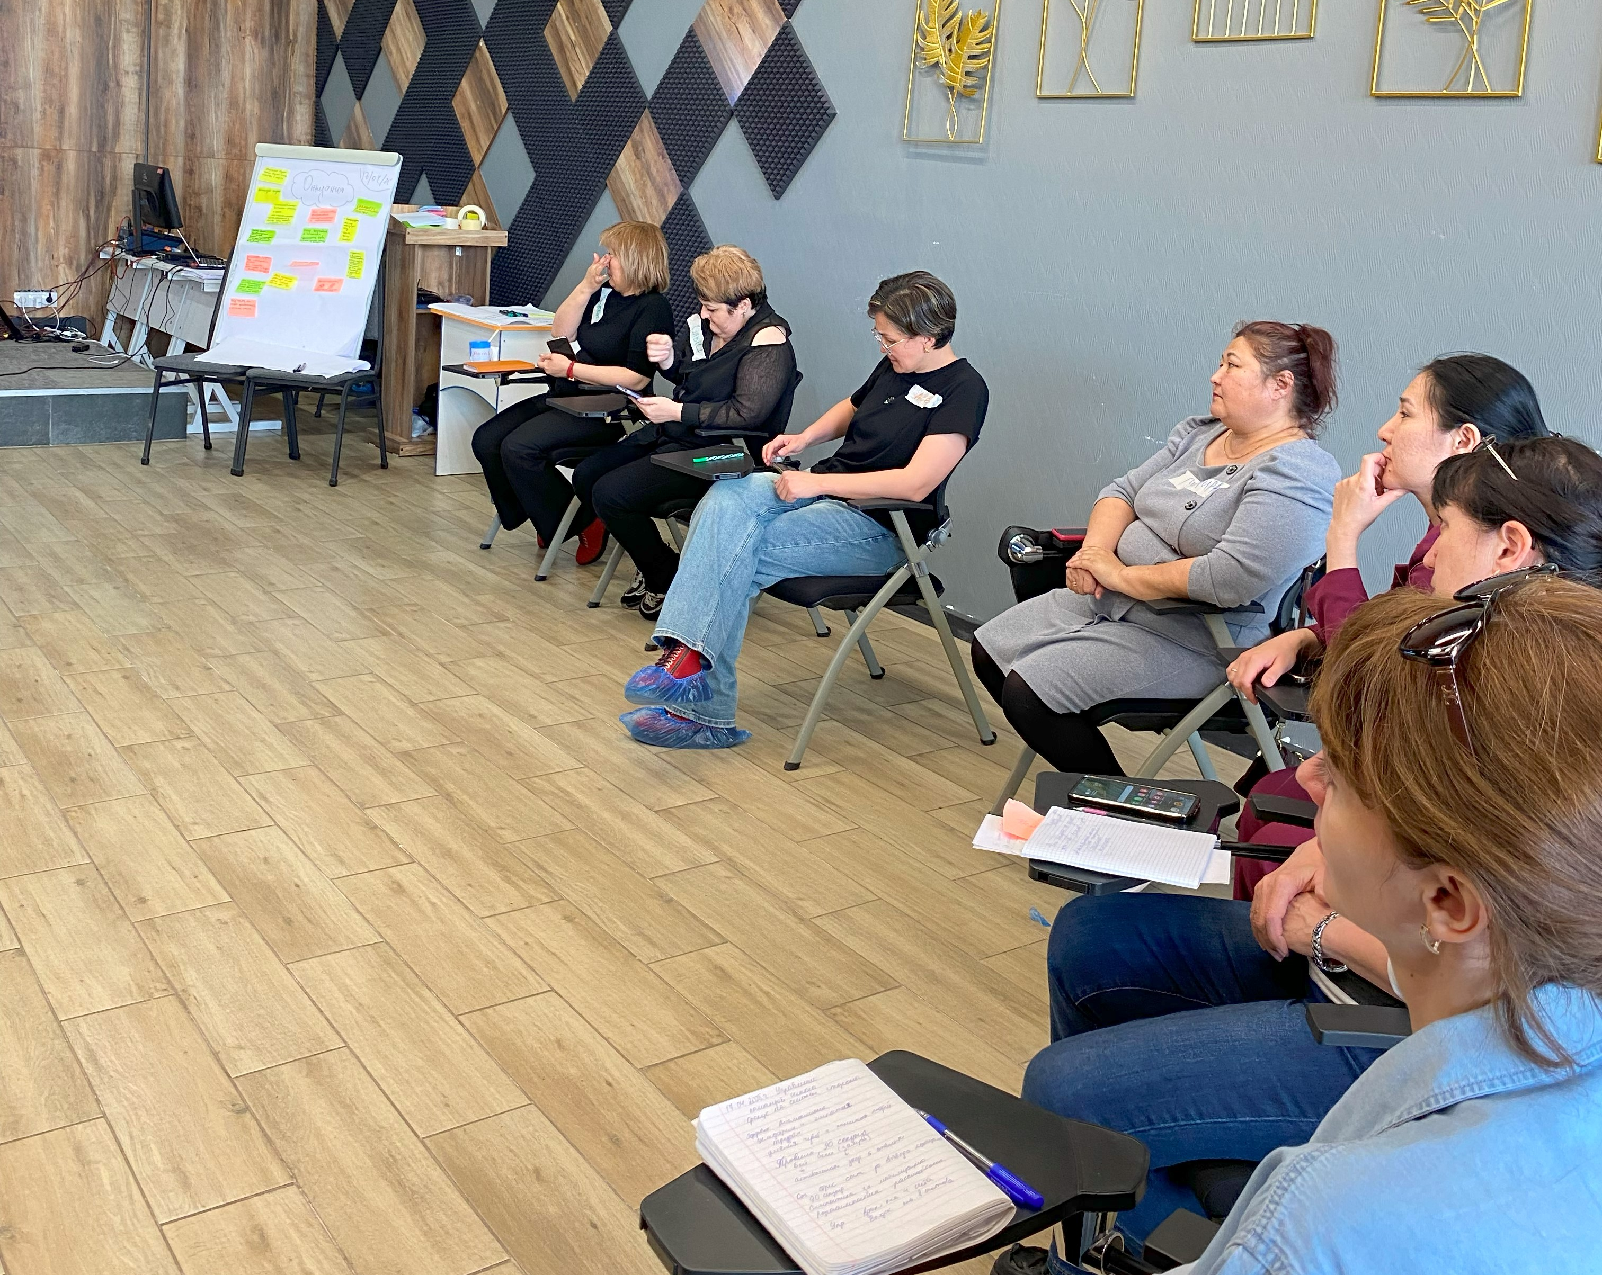
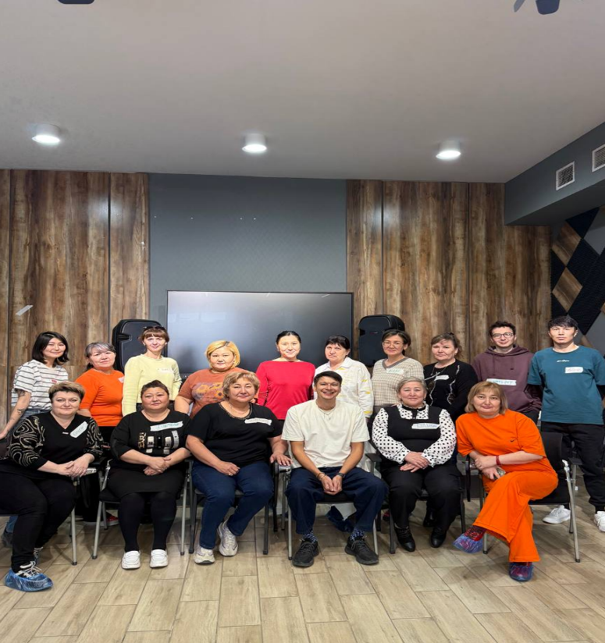
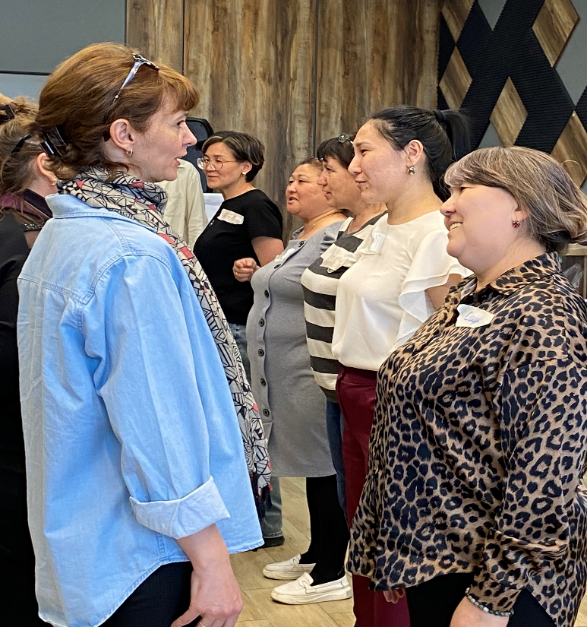
ENGAGEMENT WITH TEACHING STAFF IN PARTNER SCHOOLS: ENHANCING THE EFFECT OF SYSTEM CHANGE
Training school staff
Training school administration
Teacher Support Activities
350+ teachers in 7 schools
participated
3 focus areas:
The role of adults in children's lives during rapid change
Impact of transformation on school environments and students
Educators’ personal and collective responsibility in their communities
Strategic Vision: Understanding schools as holistic systems
Personal Leadership: Support for developing leadership identity
Culture of Collaboration: Promoting team-based thinking
Focus groups to assess teacher needs
Thematic group chats
Monthly “Meaningful Saturdays”

Slide 11
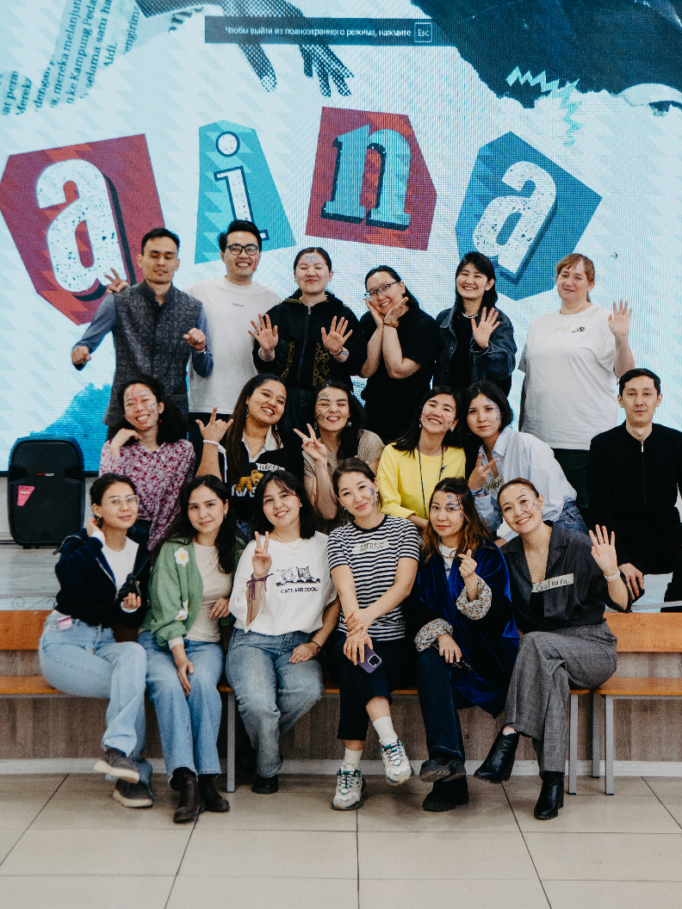
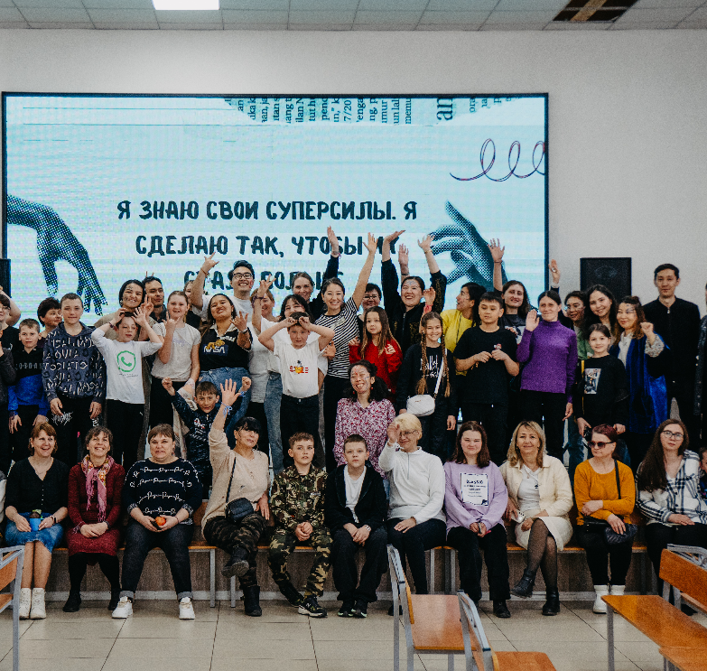

MIRRORS OF UNDERSTANDING:
HOW THE 'AINA' FESTIVAL UNITES GENERATIONS
“Aina" – More Than a Festival
A true laboratory of self-discovery through deep reflection and participatory exploration
The 5 Facets of Identity We Explore:
Sezim (Feelings & Emotions):
Tamyr (Roots):
Super Kúsh (My Superpower):
Biz (We):
Ózgeris (Change & Impact):
A space for emotional intelligence— parents and children openly share unspoken feelings
A journey into family history, names, traditions, and cultural memory
Discovery of personal talents, dreams, and inner resources
Realization of belonging—community as a mirror for self- awareness
How we influence and are influenced—our families, schools, cities, and country

Slide 12
FINANCIAL TRANSPARENCY –
А CORE PRINCIPLE OF OUR WORK
FOUNDATION EXPENSE STRUCTURE
FROM JANUARY 1 TO JULY 1, 2025
A transparent, diversified funding model supports sustainable growth and accountability. Key financial indicators for the reporting period demonstrate the stable performance of the Foundation.
INDICATOR, THOUSAND TENGE | 2022 | 2023 | 2024 | FROM JANUARY 1 TO JULY 1, 2025
Opening Balance | 0 | 145 112 | 219 794 | 329 887
Receipts for the Period | 167 620 | 454 650 | 602 125 | 141 356
Total Available | 167 620 | 599 762 | 821 919 | 471 242
Expenditures for the Period | 22 508 | 379 968 | 492 033 | 280 585
Closing Balance | 145 112 | 219 794 | 329 887 | 190 657
REVENUE STRUCTURE (2022–2025)
2022-2024 ж.
from January 1 to July 1, 2025
The structure of expenses reflects a clear priority for programmatic activities over administrative costs—aligning with best practices for nonprofit management.
Financial statements for 2024 have been verified by an independent auditor:
Baker Tilly LLP, a member of the global Baker Tilly network.

Slide 13
TFQ TEAM ENGAGEMENT SURVEY RESULTS
Team Engagement - A Key Success Factor
Employee engagement helps us build a united community where everyone feels valued and recognizes their contribution to our shared mission.
In 2024,
90%
of staff
OVERALL ENGAGEMENT
4.1
Five highest scoring questions | 2025 | 2024
I believe in what Teach for Qazaqstan is trying to achieve | 4.7 | 4.7
I understand how my work contributes to the success of Teach for Qazaqstan | 4.4 | 4.4
I get the chance to use my skills and abilities in my job | 4.3 | 4.1
My manager encourages my leadership development | 4.3 | NA¹
I know what is expected of me in my job | 4.2 | 3.9
participated in the survey —
a high response rate and strong representation
Objectives and
Aspirations
3.7
Accountabilities and Collaboration
4.0
Performance Management
and Recognition
3.3
The overall engagement level of
4,1
People Manager Capabilities and Interactions
3.9
Wellbeing and Inclusiveness
3.7
Flexibility and Empowerment
3.9
is consistently high and comparable to the Teach For All network average (4.4)
Immediate action
Watch
Strong

Slide 14
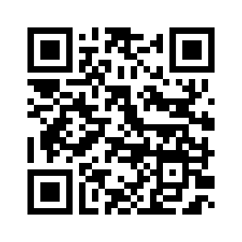
THANK YOU FOR YOUR ATTENTION
Please scan for contact details

